Slide 1
Network Requirements
Eli Dart, Network Engineer
ESnet Science Engagement
Lawrence Berkeley National Laboratory
2014 ESGF and UV-CDAT Conference
Livermore, CA
December 9, 2014

Slide 2
Overview
ICNWG background and efforts
Network as Instrument
What’s Next?

Slide 3
International collaboration between NRENs to support researchers in using networks
ESnet (US), Funet (FI), Internet2 (US), Janet (UK), SURFnet (NL)
2013 program awards included
Engineering support and expertise for 4 proposals (2 in climate science)
10G link upgrade for KNMI
Program motivations
All research is global—especially science
Data requirements are increasing
Networks can make an impact to help research progress
International Climate Network Working Group (ICNWG)
ESGF working group
Current task is to manage EYR-assisted improvements

Slide 4

ICNWG purpose and goals
International Climate Network Working Group
ESGF working group
Currently congruent with EYR-Global award
http://icnwg.llnl.gov/
Purpose: improve data transfer performance between major climate data facilities
Current tools (http/wget) won’t scale to CMIP6 data volumes
Technologies exist to significantly improve performance
Science DMZ
Globus
Near-term goals – replication workflow using GridFTP
500MB/sec network performance by May 2014
500MB/sec (4Gbps) disk to disk transfer by August 2014
Longer-term goals
1GB/sec (8Gbps) disk to disk by August 2015
2GB/sec (16Gbps) disk to disk by June 2016 (stretch goal)
Notes:
Formed December 2013 at ESGF meeting, LLNL as part of ESGF

Slide 5





























…and many more...
Notes:
Small portion of the ESGF organizations participating in ICNWG
In Boulder we talked about increasing participation

Slide 6
ICNWG Progress
Several perfSONAR hosts are up
https://icnwg.llnl.gov/
Also http://ps-dashboard.es.net/index.cgi?dashboard=7%3A%20ESnet%20to%20Climate%20Sites
(go to http://ps-dashboard.es.net/ and select “Climate Sites” from the Dashboards drop-down on the left)
Some DTN testing has been done
Much work remains
Would be useful to work more closely with replication group
Significant performance upgrades still needed
Let’s talk a bit about network performance

Slide 7
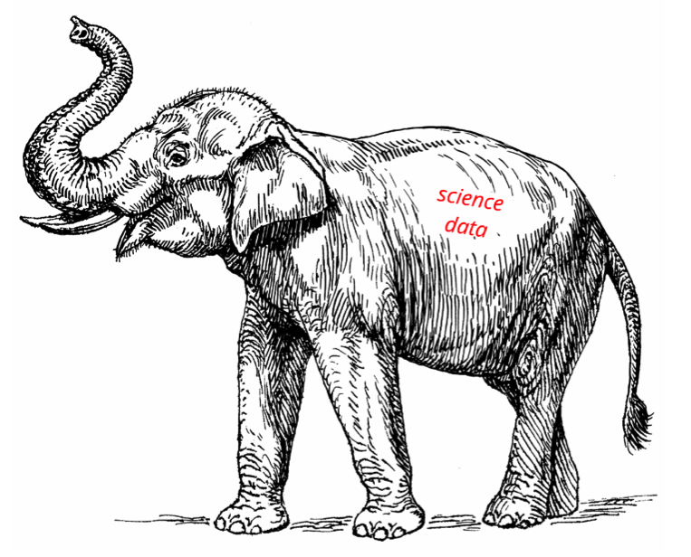
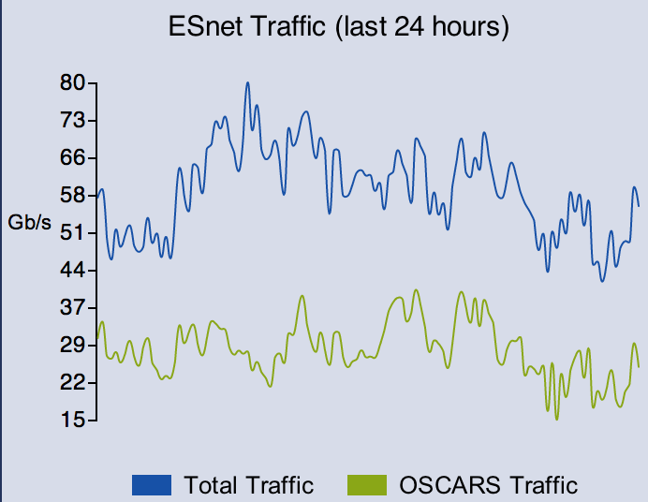
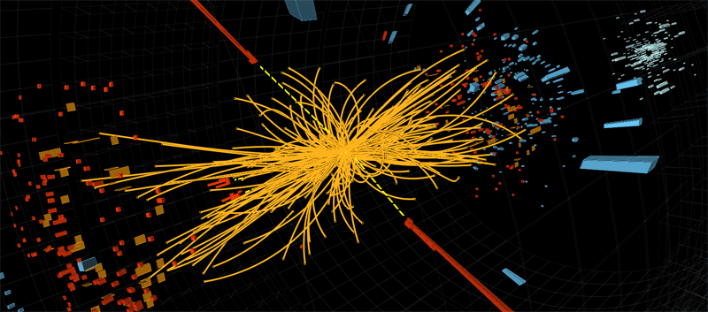



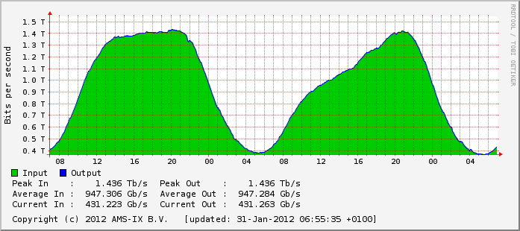



Science Traffic Profile is Different
Notes:
ESnet has many capabilities that commercial internet providers do not. I’ll speak about just one.
Commodity internet traffic – large flow count, small per-flow bandwidth, diurnal time signature
Science traffic – small flow count, large per-flow bandwidth, workflow-driven time signature

Slide 8


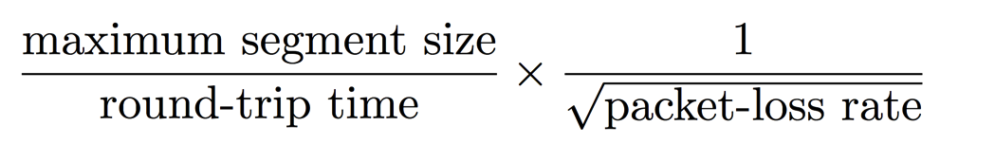
Elephant Flows Place Great Demands on Networks
Physical pipe that leaks water at rate of .0046% by volume.
Result 99.9954% of water transferred.
➔
➔
Result
100% of data transferred, slowly, at <<5% optimal speed.
Network ‘pipe’ that drops packets at rate of .0046%.
➔
➔
essentially fixed
With proper engineering, we can minimize packet loss.
determined by speed of light
Assumptions: 10Gbps TCP flow, 80ms RTT.
See Eli Dart, Lauren Rotman, Brian Tierney, Mary Hester, and Jason Zurawski. The Science DMZ: A Network Design Pattern for Data-Intensive Science. In Proceedings of the IEEE/ACM Annual SuperComputing Conference (SC13), Denver CO, 2013.
Notes:
It turns out a network has to be almost perfect in order to move the elephant flows effectively.
This is a little bit counterintuitive.
We have to take special care in engineering for the elephant flows.
Irony: van jacobsen 1986 – 88.
This is why a network specifically engineered for science is important

Slide 9
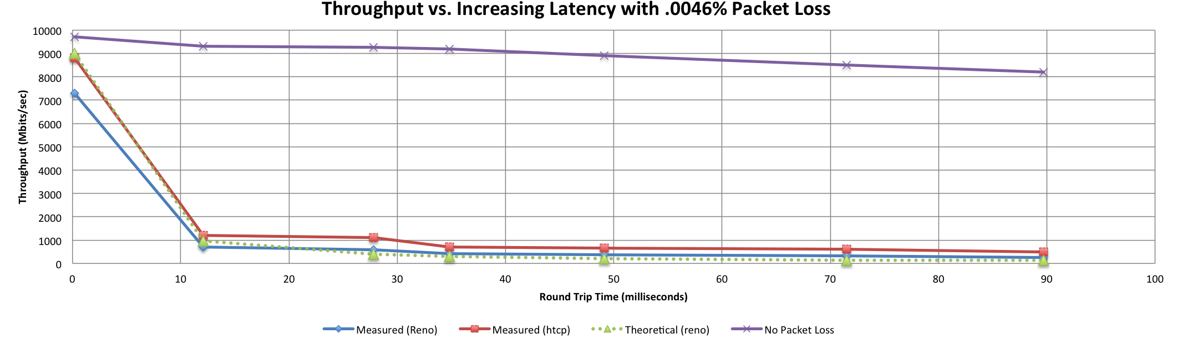
A small amount of packet loss makes a huge difference in TCP performance
Local
(LAN)
With loss, high performance beyond metro distances is essentially impossible
International
Metro Area
Regional
Continental
Measured (TCP Reno)
Measured (HTCP)
Theoretical (TCP Reno)
Measured (no loss)
Notes:
When we solve this problem, the network can be part of the instrument.
This is an annotated version of the plot from the Science DMZ paper
Beyond your metro area, zero loss is essentially required for high performance
Where are your collaborators? Where are your users?
When global collaboration is the norm, nobody can afford to be a local-only resource

Slide 10
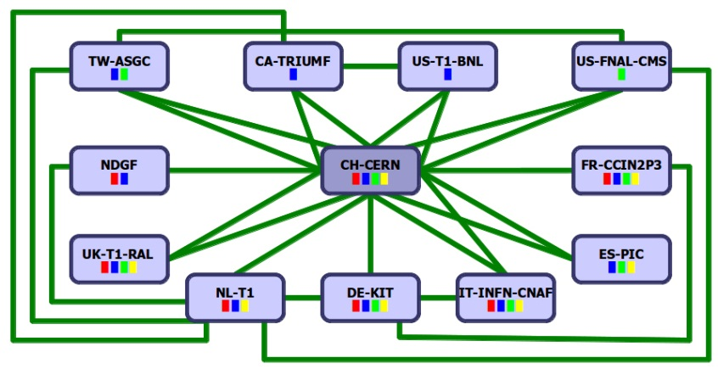
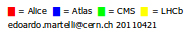
Network-Centric View of Large Hadron Collider (@CERN)
Q1: where does “discovery” occur?
detector
1 PB/s
Q2: where does the “instrument” end?
O(1-10) meter
Level 1 and 2 triggers
O(10-100) meters
CERN →T1 | miles | kms
France | 350 | 565
Italy | 570 | 920
UK | 625 | 1000
Netherlands | 625 | 1000
Germany | 700 | 1185
Spain | 850 | 1400
Nordic | 1300 | 2100
USA – New York | 3900 | 6300
USA - Chicago | 4400 | 7100
Canada – BC | 5200 | 8400
Taiwan | 6100 | 9850
Level 3 trigger
O(1) km
LHC Tier 0 Deep archive and send data to Tier 1 centers
CERN Computer Center
~50 Gb/s (25Gb/s ATLAS, 25Gb/s CMS)
500-10,000 km
Universities/
physics groups
Universities/
physics groups
Universities/
physics groups
Universities/
physics groups
LHC Tier 1 Data Centers
Universities/
physics groups
Universities/
physics groups
Universities/
physics groups
Universities/
physics groups
The LHC Open Network Environment
(LHCONE)
Universities/
physics groups
Universities/
physics groups
Universities/
physics groups
Universities/
physics groups
The LHC Optical Private Network (LHCOPN)
Universities/
physics groups
Universities/
physics groups
Source: Bill Johnston
Universities/
physics groups
LHC Tier 2 Analysis Centers
Universities/
physics groups
Universities/
physics groups
Notes:
If we take this network-centric view of the LHC (Bill Johnston) it’s even harder to isolate the point of discovery.
Here’s an elaborate international data distribution model.
Two questions: it’s kind of hard to say. Doesn’t appear to be so local.
Clear that discovery is a distributed process. It doesn’t really happen in one singular place: the detector, or at the cluster. Or simply the mind of the physicist.
The network is more than an infrastructure here. It’s part of a distributed instrument for discovery.

Slide 11
Evolution of LHC Data Model
In chronological order:
Copy as much data as feasible to analysis centers worldwide, with hierarchical distribution.
Relax the hierarchy and rely on caching.
Use “federated data stores” to fetch portions of relevant data sets from remote storage (anywhere), just before they’re needed.
Increasing faith in global science networks.
Notes:
This remote IO model is taking hold in HEP, and will in other disciplines.
It is much, much cheaper to move data than to store it twice.

Slide 12
What Comes Next?
CMIP6
Still being finalized
Possible data scale: 4x or 5x larger than CMIP5 (CMIP6: ~10PB)
Performance improvements needed for data transfer between major sites
Data sets still need to be moved, and will probably need to be moved for some time
There is a need for this – can we do it?
I will argue that we can
This is not intended to replace server-side analysis
There is still a need for movement between major sites
I believe we can meet that need

Slide 13
Data – How Much Can You Use?
Many scientists don’t have their own HPC facility
They have an account with an allocation someplace
XSEDE, DOE, …
Most accounts some with a storage allocation as well
Disk quota determines easy working set size
Stay under quota or lots of stuff breaks
What is the size of a “normal” storage quota?
Say your center offers 10TB of scratch
If you ask, you can get it increased (up to a point)
Above 100TB is probably hard (10 such users = 1PB)
Let’s pretend we can get our disk quota raised to 100TB
What is required to move 100TB?

Slide 14
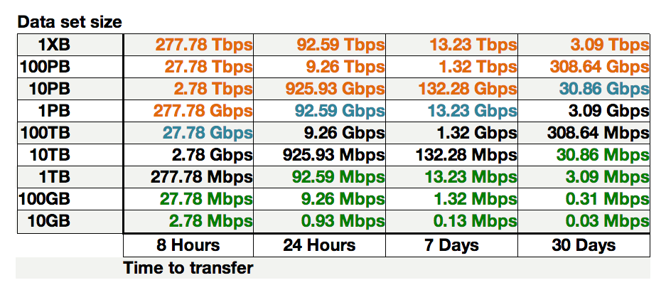
Sample Data Transfer Rates
This table available at:
http://fasterdata.es.net/fasterdata-home/requirements-and-expectations/
Notes:
From a 100G perspective, 1TB/hour is trivial – gated completely on end systems
Some collaborations already need 1PB/week – 14Gbps – not much work for 100G network, more work for storage systems

Slide 15
What Can Be Done With 100TB Of Disk?
What analyses could be done in a 100TB storage envelope?
The future is all up and to the right
Data volume will increase
Filesystem capacities will grow
What does this mean for scientists?
What type of questions do scientists want to ask?
How much data is required to answer those questions?
Data infrastructure should be able to provide the data on human-reasonable time scales
What wait time is appropriate?
100TB/week?
Notes:
Even if CMIP6 is not 10EB, data volume still grows

Slide 16
Vision
Deploy Science DMZs at the major sites, connected to the science networks
Major climate modeling centers
Major data centers
HPC facilities
This is being done now for the LHC experiments (prep for run 2)
The LHC folks have been doing this for some time – 3rd architecture now
Climate can benefit from the experience of the LHC experiments
Make it easy for big data to move
No worries about the small scale users
Get the big users what they need
10s of TB on human-reasonable time scales
Less human work for data staging
Some climate sites are doing this now – others have more work to do

Slide 17
Data Performance Engineering For Climate
Data performance team
ESnet, other networks (JANET, GEANT, AARNet, et. al.)
Major data centers (PCMDI, NCAR, NASA, NOAA, DKRZ, BADC, ANU/NCI, KNMI, IPSL, etc.)
Leverage EYR work – expand ICNWG
Center-to-center data performance targets
Regular performance monitoring
This is what the LHC experiments have done – it works
ESnet can help
Notes:
This is very operationally-focused

Slide 18
Thanks!
Eli Dart dart@es.net
Energy Sciences Network (ESnet)
Lawrence Berkeley National Laboratory
http://fasterdata.es.net/
http://my.es.net/
http://www.es.net/

Slide 19
Extra Slides

Slide 20
Climate CrossConnects – July 2014, Boulder, CO
CrossConnects workshop series
Bring together scientists, technologists, data managers, senior leadership
Interactive discussion, working toward strategic advances
Climate CrossConnects
“Improving Data Mobility & Management for International Climate Science”
Sponsored by ESnet and Internet2
Co-sponsors
Indiana University
National Center for Atmospheric Research (NCAR)
National Oceanic and Atmospheric Administration (NOAA)
Hosted by NOAA in Boulder, CO
Excellent facility
Excellent support

Slide 21
Broad Attendance – 88 People
International
Americas
Asia
Australia
Europe
Many institutions represented
Universities
Research Laboratories
Mission agencies
Industry
Special thanks to NSF for travel funds for some attendees
http://www.nsf.gov/awardsearch/showAward?AWD_ID=1445821&HistoricalAwards=false
Notes:
So – what did we learn?

Slide 22
Climate CrossConnects – Takeaways
We have a bunch of different components
Many organizations
Internal missions and external missions
Research, operations, etc.
Synergistic interaction with related organizations
Lots of data
In many cases data is not where the compute is
If you can use a subsetting service, fine
But – no liquid market in fungible computing allocations
You’ve got cycles where you’ve got cycles
If the data isn’t already there, need a way to put it there
The big users have a big problem
Potential for huge progress if this can all be integrated
How can we do this?

Slide 23
Progress Under Way
NOAA already has an advanced workflow for managing large-scale data
Multiple sites
Fault detection and recovery
High performance
NASA upgrading its mission infrastructure for observational data
Instruments produce more data
Project underway (well-understood – good people on the case)
ESGF data replication upgrades
Supported by Enlighten Your Research program
https://www.enlightenyourresearch.net/?page_id=291
Major ESGF data centers
Also, ESGF working on Globus integration

Slide 24
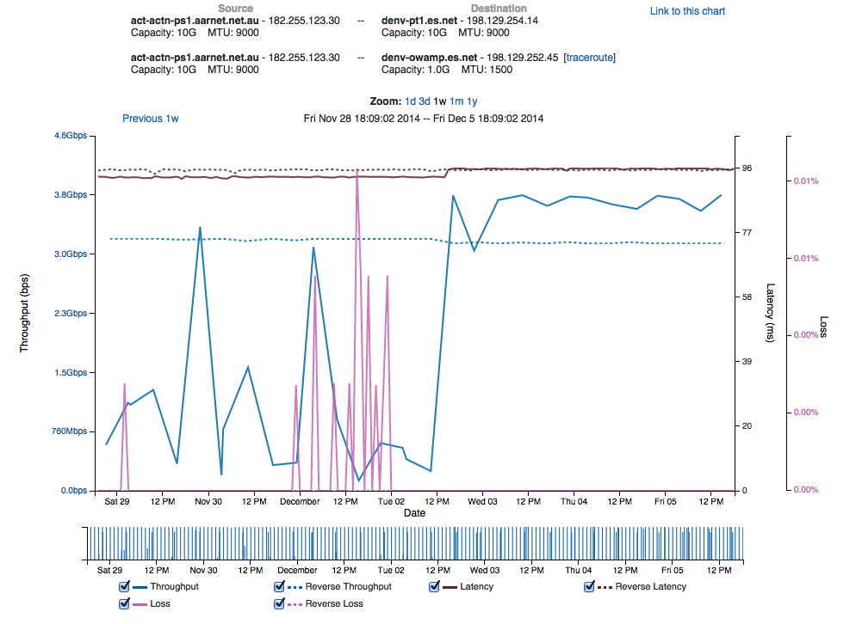
Network Upgrades Matter
Peering moved from 10G link to 100G link
Latency change shows path change
US-AU performance good, stable
Performance increases
Performance stabilizes
Packet loss goes away
AU-US performance unstable
Low performance in general case
Note packet loss

Slide 25
Where’s the Data?
Data are typically analyzed using computers
This means that in order to do the analysis, the data must be accessible by an application running on the computer
Usually, that means the computer and the data must be collocated
Data on a filesystem accessible to applications running on the computer
This seems obvious, right?
In a lot of cases, moving the data is difficult for users
#include <perf_litany.h>
“Move the computation to the data!”
Of course! (if you can…)
People do this whenever possible (e.g. LHC experiments do this a lot)
However, this is often not possible. Why?

Slide 26
Can’t Always Move Compute To Data
A liquid market in fungible HPC allocations does not exist
Users get an allocation of time and storage on a specific resource
That allocation is generally not portable
Account management/security
Machine architecture, tools, etc.
In order to use the allocation, user moves data to the computer if it’s not already there
Other reasons as well
Compute does not always exist near the data (light sources, LHC, etc.)
Data moves to user-owned compute resource
Therefore, data mobility must be supported by facilities
Put the data in the right place, regardless of where it is now
This need will not go away
The structure of modern science assumes this capability exists
We need it because we often can’t move the computation to the data

Slide 27
Protocol Behavior (TCP)
Networks provide connectivity between hosts – how do hosts see the network?
From an application’s perspective, the interface to “the other end” is a socket
Communication is between applications – mostly over TCP
TCP – the fragile workhorse
TCP is (for very good reasons) timid – packet loss is interpreted as congestion
Packet loss in conjunction with latency is a performance killer
Like it or not, TCP is used for the vast majority of data transfer applications (more than 95% of ESnet traffic is TCP)
How badly does loss affect performance?

Slide 28
Protocol Behavior (TCP)
Local
(LAN)
With loss, high performance beyond metro distances is essentially impossible
International
Metro Area
Regional
Continental
Measured (TCP Reno)
Measured (HTCP)
Theoretical (TCP Reno)
Measured (no loss)
Notes:
This is an annotated version of the plot from the Science DMZ paper
Beyond your metro area, zero loss is essentially required for high performance
Where are your collaborators? Where are your users?
When global collaboration is the norm, nobody can afford to be a local-only resource

Slide 29
The Science DMZ*: A Network Design Pattern for Data-Intensive Science
Energy Sciences Network (ESnet)
Lawrence Berkeley National Laboratory
Last Updated August 18th, 2014
* Science DMZ is a trademark of The Energy Sciences Network (ESnet)

Slide 30
Overview
Science DMZ Motivation and Introduction
Science DMZ Architecture
Network Monitoring
Data Transfer Nodes & Applications
Science DMZ Security
User Engagement
Wrap Up
© 2014, Energy Sciences Network

Slide 31
Motivation
Networks are an essential part of data-intensive science
Connect data sources to data analysis
Connect collaborators to each other
Enable machine-consumable interfaces to data and analysis resources (e.g. portals), automation, scale
Performance is critical
Exponential data growth
Constant human factors
Data movement and data analysis must keep up
Effective use of wide area (long-haul) networks by scientists has historically been difficult
© 2014, Energy Sciences Network
Notes:
Human factors – attention span, ability to manage complexity – these are constant
There is a huge amount of promise in data-intensive science. Effective use of networks can help realize those benefits.
The Science DMZ model helps address the difficulties scientists often experience with using networks.

Slide 32
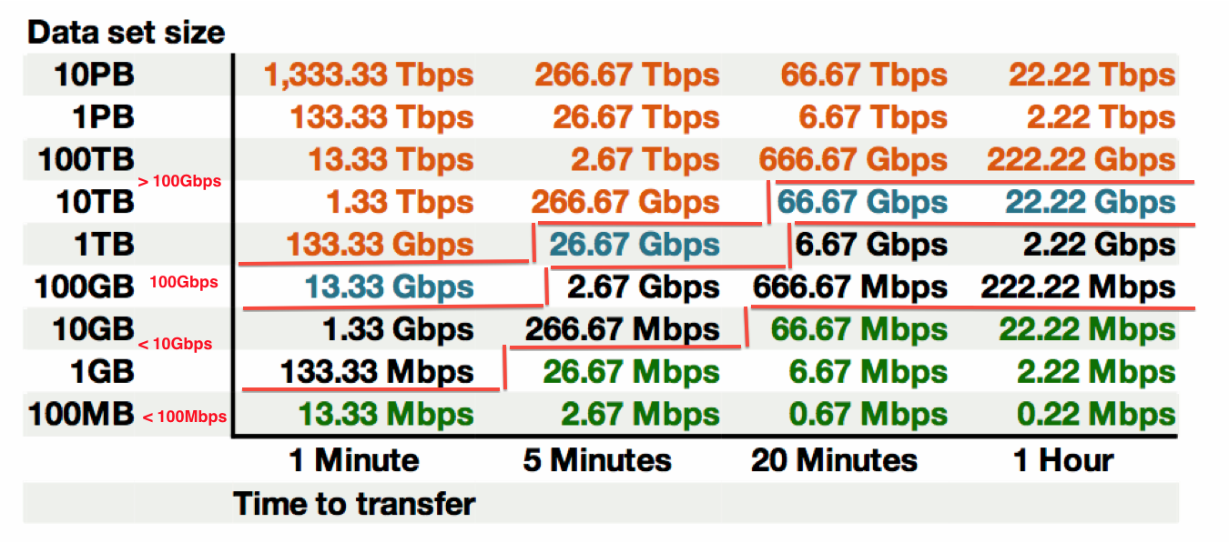
Data Mobility in a Given Time Interval
This table available at:
http://fasterdata.es.net/fasterdata-home/requirements-and-expectations/
© 2014, Energy Sciences Network
Notes:
This succinctly describes what the end to end data path must achieve – network, hosts, storage, application
Green: <= 100Mbps Throughput (almost all domestic locations can do this) – less than Fast Ethernet!
Black: 100Mbps to 10Gbps Throughput (most major research institutions can do this, if its running clean)
Blue 10Gbps to 100Gbps Throughput (emerging at major locations)
Orange > 100Gbps Throughput (future for many)
Note: 1TB/hour and 100TB/week fit easily within 10G of throughput

Slide 33
The Central Role of the Network
The very structure of modern science assumes science networks exist: high performance, feature rich, global scope
What is “The Network” anyway?
“The Network” is the set of devices and applications involved in the use of a remote resource
This is not about supercomputer interconnects
This is about data flow from experiment to analysis, between facilities, etc.
User interfaces for “The Network” – portal, data transfer tool, workflow engine
Therefore, servers and applications must also be considered
What is important? Ordered list:
Correctness
Consistency
Performance
© 2014, Energy Sciences Network
Notes:
Networks are key. However, the user interface runs on systems at the edges.
The ordered list of important items is derived from the users of the network:
1) If a tool doesn’t behave correctly, the tool is broken – get another tool
2) If the tool doesn’t behave consistently, I can’t organize my life
3) Among the tools that behave correctly and consistently, choose the tool with the required performance that is easiest to use

Slide 34
TCP – Ubiquitous and Fragile
Networks provide connectivity between hosts – how do hosts see the network?
From an application’s perspective, the interface to “the other end” is a socket
Communication is between applications – mostly over TCP
TCP – the fragile workhorse
TCP is (for very good reasons) timid – packet loss is interpreted as congestion
Packet loss in conjunction with latency is a performance killer
Like it or not, TCP is used for the vast majority of data transfer applications (more than 95% of ESnet traffic is TCP)
© 2014, Energy Sciences Network
Notes:
The application sees the network as a socket.
The socket interface does not provide path diagnostics or other troubleshooting information.
TCP behaves as it does because of measures taken in the 1980s to fix the congestion collapse of the Internet
TCP makes a promise to the application – TCP will get the data to the other end, or TCP will return an error. TCP makes no promises about performance.

Slide 35
A small amount of packet loss makes a huge difference in TCP performance
Local
(LAN)
With loss, high performance beyond metro distances is essentially impossible
International
Metro Area
Regional
Continental
Measured (TCP Reno)
Measured (HTCP)
Theoretical (TCP Reno)
Measured (no loss)
© 2014, Energy Sciences Network
Notes:
This is an annotated version of the plot from the Science DMZ paper
Beyond your metro area, zero loss is essentially required for high performance
Where are your collaborators? Where are your users?
When global collaboration is the norm, nobody can afford to be a local-only resource

Slide 36
Working With TCP In Practice
Far easier to support TCP than to fix TCP
People have been trying to fix TCP for years – limited success
Like it or not we’re stuck with TCP in the general case
Pragmatically speaking, we must accommodate TCP
Sufficient bandwidth to avoid congestion
Zero packet loss
Verifiable infrastructure
Networks are complex
Must be able to locate problems quickly
Small footprint is a huge win – small number of devices so that problem isolation is tractable
© 2014, Energy Sciences Network
Notes:
Do not underestimate the value of three TCP improvements:
RFC1323 (window scaling)
Kernel autotuning
Improved congestion algorithms
However, loss + latency is still a performance killer.
TCP must be accommodated – this is our job as engineers and architects

Slide 37
Putting A Solution Together
Effective support for TCP-based data transfer
Design for correct, consistent, high-performance operation
Design for ease of troubleshooting
Easy adoption is critical
Large laboratories and universities have extensive IT deployments
Drastic change is prohibitively difficult
Cybersecurity – defensible without compromising performance
Borrow ideas from traditional network security
Traditional DMZ
Separate enclave at network perimeter (“Demilitarized Zone”)
Specific location for external-facing services
Clean separation from internal network
Do the same thing for science – Science DMZ
© 2014, Energy Sciences Network
Notes:
In order to accommodate TCP, we need a pragmatic engineering solution that:
Addresses the needs
Is implementable given financial, policy, and cultural constraints
Can be defended – we cannot ignore security

Slide 38
The Science DMZ Design Pattern
Dedicated Systems for Data Transfer
Network Architecture
Performance Testing & Measurement
perfSONAR
Enables fault isolation
Verify correct operation
Widely deployed in ESnet and other networks, as well as sites and facilities
Data Transfer Node
High performance
Configured specifically for data transfer
Proper tools
Science DMZ
Dedicated network location for high-speed data resources
Appropriate security
Easy to deploy - no need to redesign the whole network
© 2014, Energy Sciences Network
Notes:
The Science DMZ design pattern is a set of composable ideas, including:
The architectural element itself – the Science DMZ enclave
Appropriate security that does not impact performance
Dedicated systems – Data Transfer Nodes
perfSONAR
The elements of the Science DMZ can be combined in a variety of ways depending on the need

Slide 39
Abstract or Prototype Deployment
Add-on to existing network infrastructure
All that is required is a port on the border router
Small footprint, pre-production commitment
Easy to experiment with components and technologies
DTN prototyping
perfSONAR testing
Limited scope makes security policy exceptions easy
Only allow traffic from partners
Add-on to production infrastructure – lower risk
© 2014, Energy Sciences Network

Slide 40
Science DMZ Design Pattern (Abstract)
© 2014, Energy Sciences Network
Notes:
This is an abstract cartoon – nobody’s network looks exactly like this
The diagram has no management LAN, no terminal servers, etc.
However, this is the minimum network diagram that shows the essential Science DMZ components:
Science DMZ enclave
DTN
perfSONAR (in the WAN, at the border, in the Science DMZ)
Security policy controls

Slide 41
Local And Wide Area Data Flows
© 2014, Energy Sciences Network
Notes:
The green data path is susceptible to TCP performance problems stemming from packet loss combined with long distances
The red data path is very low latency – loss matters much less here (though too much loss will still cause problems)
Remember the throughput vs. latency graph

Slide 42
Support For Multiple Projects
Science DMZ architecture allows multiple projects to put DTNs in place
Modular architecture
Centralized location for data servers
This may or may not work well depending on institutional politics
Issues such as physical security can make this a non-starter
On the other hand, some shops already have service models in place
On balance, this can provide a cost savings – it depends
Central support for data servers vs. carrying data flows
How far do the data flows have to go?
© 2014, Energy Sciences Network

Slide 43
Multiple Projects
© 2014, Energy Sciences Network

Slide 44
Supercomputer Center Deployment
High-performance networking is assumed in this environment
Data flows between systems, between systems and storage, wide area, etc.
Global filesystem often ties resources together
Portions of this may not run over Ethernet (e.g. IB)
Implications for Data Transfer Nodes
“Science DMZ” may not look like a discrete entity here
By the time you get through interconnecting all the resources, you end up with most of the network in the Science DMZ
This is as it should be – the point is appropriate deployment of tools, configuration, policy control, etc.
Office networks can look like an afterthought, but they aren’t
Deployed with appropriate security controls
Office infrastructure need not be sized for science traffic
© 2014, Energy Sciences Network

Slide 45
Supercomputer Center
© 2014, Energy Sciences Network
Notes:
Applying the Science DMZ design patterns to a supercomputer center
Note global filesystem – avoids double-copy workflow between DTNs and compute resources
DTNs are not part of major computational resource, and so are not entangled with its config
Science DMZ does not look discrete – however, the elements are here
Firewall appropriately placed
Security for major resources and DTNs implemented in network core
PerfSONAR for performance assurance

Slide 46
Supercomputer Center Data Path
© 2014, Energy Sciences Network
Notes:
DTNs are not part of major computational resource, and so are not entangled with its config
Note virtual circuit path (OSCARS, ION, SDN, etc)

Slide 47
Major Data Site Deployment
In some cases, large scale data service is the major driver
Huge volumes of data (Petabytes or more) – ingest, export
Large number of external hosts accessing/submitting data
Single-pipe deployments don’t work
Everything is parallel
Networks (Nx10G LAGs, soon to be Nx100G)
Hosts – data transfer clusters, no individual DTNs
WAN connections – multiple entry, redundant equipment
Choke points (e.g. firewalls) just cause problems
© 2014, Energy Sciences Network

Slide 48
Data Site – Architecture
© 2014, Energy Sciences Network
Notes:
Major data resource (e.g. LHC Tier1)
Lots of parallelism (data transfer clusters)
Firewalls as appropriate
PerfSONAR

Slide 49
Data Site – Data Path
© 2014, Energy Sciences Network
Notes:
The loss-sensitive data path covers the entire network front-end
However – note that the Science DMZ principles are all still here
Especially note security – would you want to drag all this through the enterprise firewall? Far better to do the security in the Science DMZ.

Slide 50
Distributed Science DMZ
Fiber-rich environment enables a distributed Science DMZ
No need to accommodate all equipment in one location
Allows the deployment of institutional science service
WAN services arrive at the site in the normal way
Dark fiber distributes connectivity to Science DMZ services throughout the site
Departments with their own networking groups can manage their own local Science DMZ infrastructure
Facilities or buildings can be served without building up the business network to support those flows
Security is more complex
Remote infrastructure must be monitored
Several technical remedies exist (arpwatch, no DHCP, separate address space, etc.)
Solutions depend on relationships with security groups
© 2014, Energy Sciences Network

Slide 51
Distributed Science DMZ – Dark Fiber
© 2014, Energy Sciences Network
Notes:
This provides distributed connectivity to a central Science DMZ

Slide 52
Multiple Science DMZs – Dark Fiber
© 2014, Energy Sciences Network
Notes:
In this case, each Science DMZ can be run separately (e.g. by individual departments or laboratories)

Slide 53
Development Environment
One thing that often happens is that an early power user of the Science DMZ is the network engineering group that builds it
Service prototyping
Deployment of test applications for other user groups to demonstrate value
The production Science DMZ is just that – production
Once users are on it, you can’t take it down to try something new
Stuff that works tends to attract workload
Take-home message: plan for multiple Science DMZs from the beginning – at the very least you’re going to need one for yourself
The Science DMZ model easily accommodates this
© 2014, Energy Sciences Network
Notes:
Example of workload – ALS DTN became central to most data handling tasks on the beamline within about a month of deployment
The Science DMZ model can easily be replicated because of its modularity

Slide 54
Science DMZ – Flexible Design Pattern
The Science DMZ design pattern is highly adaptable to research
Deploying a research Science DMZ is straightforward
The basic elements are the same
Capable infrastructure designed for the task
Test and measurement to verify correct operation
Security policy well-matched to the environment, application set is strictly limited to reduce risk
Connect the research DMZ to other resources as appropriate
The same ideas apply to supporting an SDN effort
Test/research areas for development
Transition to production as technology matures and need dictates
One possible trajectory follows…
© 2014, Energy Sciences Network
Notes:
The next couple are examples of integrating SDN into a DMZ environment
1st it is experimental, then it gradually moves into production.

Slide 55
Science DMZ – Separate SDN Connection
© 2014, Energy Sciences Network
Notes:
Initial deployment brings SDN services to research DMZ via a separate link

Slide 56
Science DMZ – Production SDN Connection
© 2014, Energy Sciences Network
Notes:
Once SDN software for the switch platform is solid and operational models are clear, production Science DMZ supports SDN

Slide 57
Science DMZ – SDN Campus Border
© 2014, Energy Sciences Network
Notes:
When the entire production path supports SDN, SDN is another production service on the Science DMZ and we’re back to the original picture
ESnet5 supports routed traffic and OSCARS on the same platform in a similar way

Slide 58
Common Threads
Two common threads exist in all these examples
Accommodation of TCP
Wide area portion of data transfers traverses purpose-built path
High performance devices that don’t drop packets
Ability to test and verify
When problems arise (and they always will), they can be solved if the infrastructure is built correctly
Small device count makes it easier to find issues
Multiple test and measurement hosts provide multiple views of the data path
perfSONAR nodes at the site and in the WAN
perfSONAR nodes at the remote site
© 2014, Energy Sciences Network

Slide 59
Multiple Ingress Flows, Common Egress
Hosts will typically send packets at the speed of their interface (1G, 10G, etc.)
Instantaneous rate, not average rate
If TCP has window available and data to send, host sends until there is either no data or no window
Hosts moving big data (e.g. DTNs) can send large bursts of back-to-back packets
This is true even if the average rate as measured over seconds is slower (e.g. 4Gbps)
On microsecond time scales, there is often congestion
Router or switch must queue packets or drop them
© 2014, Energy Sciences Network
Notes:
A brief introduction to the impacts of buffering on network traffic. Key points:
- Host interfaces ‘burst’ at line rate, and then wait (e.g. it’s binary behavior, not a nice steady pacing at some average rate)
- multiple ingress flows behave differently depending on the architecture of the switch. If its ‘shared’ memory, all may be using the same memory buffer. If each interface has its own, then 1 or 2 bursting may be less impactful on the rest of the interfaces.
- buffer bloat is typically not a concern in a Science DMZ

Slide 60
Router and Switch Output Queues
Interface output queue allows the router or switch to avoid causing packet loss in cases of momentary congestion
In network devices, queue depth (or ‘buffer’) is often a function of cost
Cheap, fixed-config LAN switches (especially in the 10G space) have inadequate buffering. Imagine a 10G ‘data center’ switch as the guilty party
Cut-through or low-latency Ethernet switches typically have inadequate buffering (the whole point is to avoid queuing!)
Expensive, chassis-based devices are more likely to have deep enough queues
Juniper MX and Alcatel-Lucent 7750 used in ESnet backbone
Other vendors make such devices as well - details are important
Thx to Jim: http://people.ucsc.edu/~warner/buffer.html
This expense is one driver for the Science DMZ architecture – only deploy the expensive features where necessary
© 2014, Energy Sciences Network
Notes:
Goes along with the previous – output is just as important as input

Slide 61
Output Queue Drops – Common Locations
© 2014, Energy Sciences Network
Notes:
In the outbound direction, traffic from the cluster goes from 10G to 1G on the department core switch – the 10G DTN will burst, causing loss if the 1G output queue is too shallow
In the outbound direction, many 1G workstations can congest a single 1G uplink port
In the inbound direction, 10G of WAN traffic goes to a 1G port facing the department core switch – likely loss location (and on the wide area path to the DTN!)
There are a lot of networks with this sort of problem.
The best way to find the problem is to use perfSONAR

Slide 62
Overview
Science DMZ Motivation and Introduction
Science DMZ Architecture
Network Monitoring
Data Transfer Nodes & Applications
Science DMZ Security
User Engagement
Wrap Up
© 2014, Energy Sciences Network

Slide 63
Performance Monitoring
Everything may function perfectly when it is deployed
Eventually something is going to break
Networks and systems are complex
Bugs, mistakes, …
Sometimes things just break – this is why we buy support contracts
Must be able to find and fix problems when they occur
Must be able to find problems in other networks (your network may be fine, but someone else’s problem can impact your users)
TCP was intentionally designed to hide all transmission errors from the user:
“As long as the TCPs continue to function properly and the internet system does not become completely partitioned, no transmission errors will affect the users.” (From RFC793, 1981)
© 2014, Energy Sciences Network
Notes:
Remember – TCP promises reliable data delivery, not performance
In order for scientists to see high-performance correct behavior consistently, network engineers must be able to find and fix problems quickly.
Waiting around for trouble tickets is clearly the wrong approach
Not all problems are immediately obvious – many are known as “soft failures”

Slide 64
Soft Network Failures – Hidden Problems
Hard failures are well-understood
Link down, system crash, software crash
Traditional network/system monitoring tools designed to quickly find hard failures
Soft failures result in degraded capability
Connectivity exists
Performance impacted
Typically something in the path is functioning, but not well
Soft failures are hard to detect with traditional methods
No obvious single event
Sometimes no indication at all of any errors
Independent testing is the only way to reliably find soft failures
© 2014, Energy Sciences Network
Notes:
If something is down hard, it’s easy to find
Soft failures are often visible only from the end systems
This is what makes perfSONAR so valuable – it behaves as an end system behaves, but it measures what the network does
Remember – we want to find the problems BEFORE the users do

Slide 65
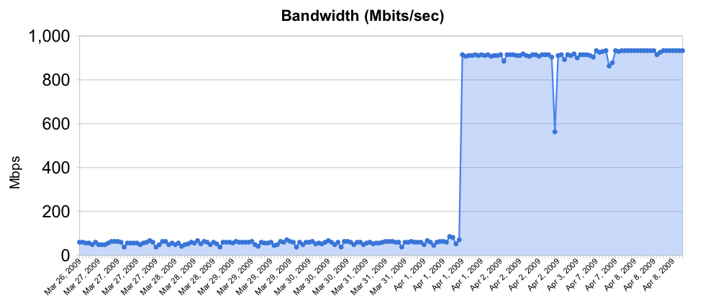
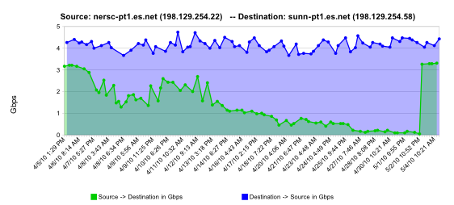
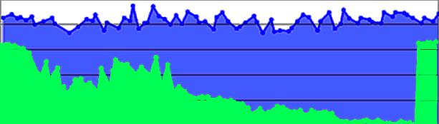
Sample Soft Failures
Rebooted router with full route table
normal performance
Gb/s
degrading performance
Gradual failure of optical line card
repair
one month
© 2014, Energy Sciences Network
Notes:
2 quick examples of soft failures:
The first of these was a Cisco 6509 that had over-filled its route table due to a misconfiguration, but the config had been fixed. The performance problem persisted until the router was rebooted. This could not have been found by auditing the configuration.
The second is a relatively common problem – in a big network there are a lot of pluggable optics packs, and sometimes they just go bad. Often they cause performance problems (soft failure) for a long time before they finally die (hard failure)

Slide 66

Testing Infrastructure – perfSONAR
perfSONAR is:
A widely-deployed test and measurement infrastructure
ESnet, Internet2, US regional networks, international networks
Laboratories, supercomputer centers, universities
A suite of test and measurement tools
A collaboration that builds and maintains the toolkit
By installing perfSONAR, a site can leverage over 1100 test servers deployed around the world
perfSONAR is ideal for finding soft failures
Alert to existence of problems
Fault isolation
Verification of correct operation
© 2014, Energy Sciences Network
Notes:
perfSONAR is the gold standard tool for performance testing, measurement, and interdomain troubleshooting in science networks

Slide 67
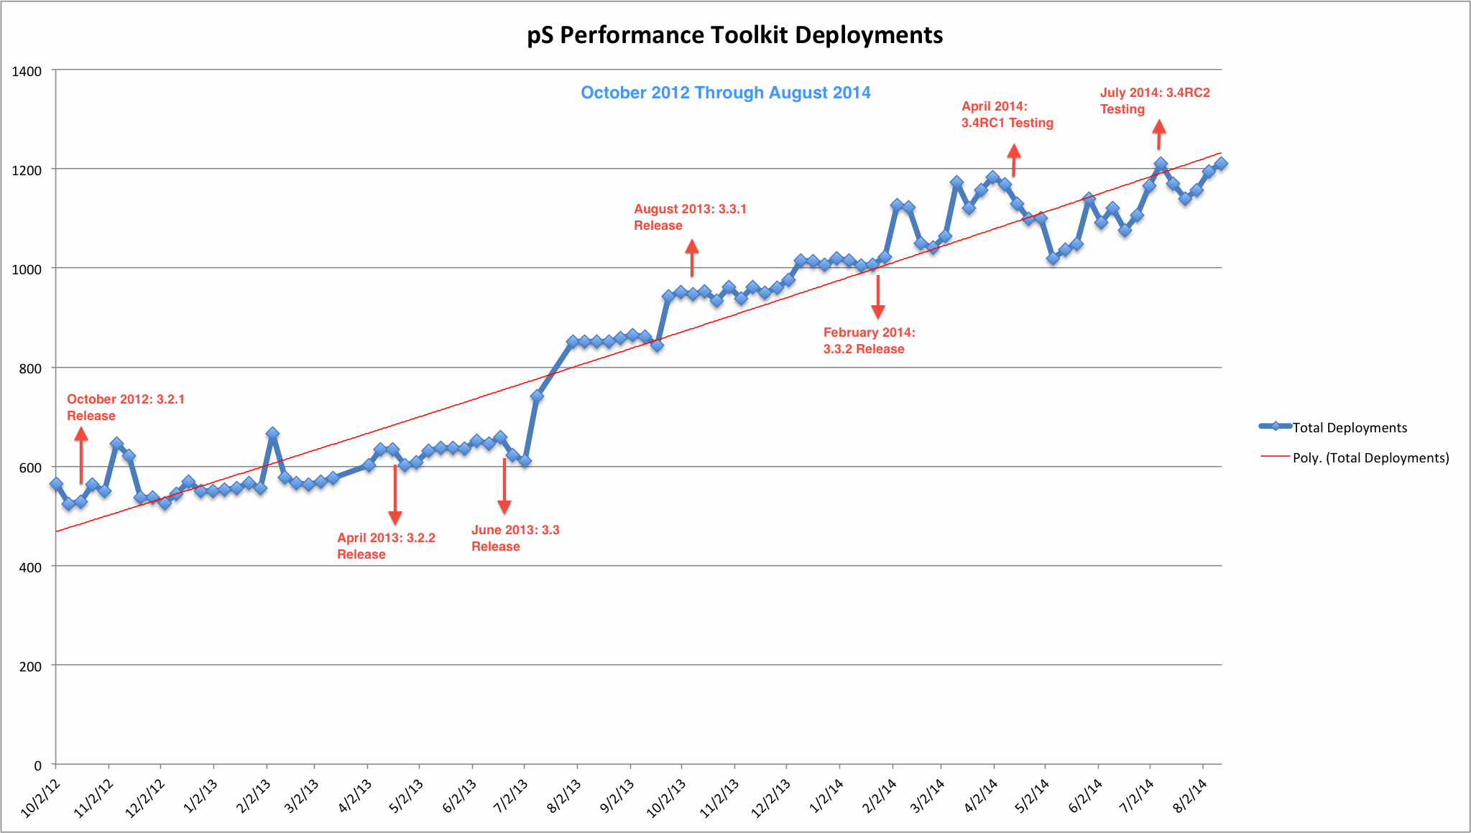
perfSONAR Deployment Footprint
© 2014, Energy Sciences Network
Notes:
Deployment curve through April 2014

Slide 68
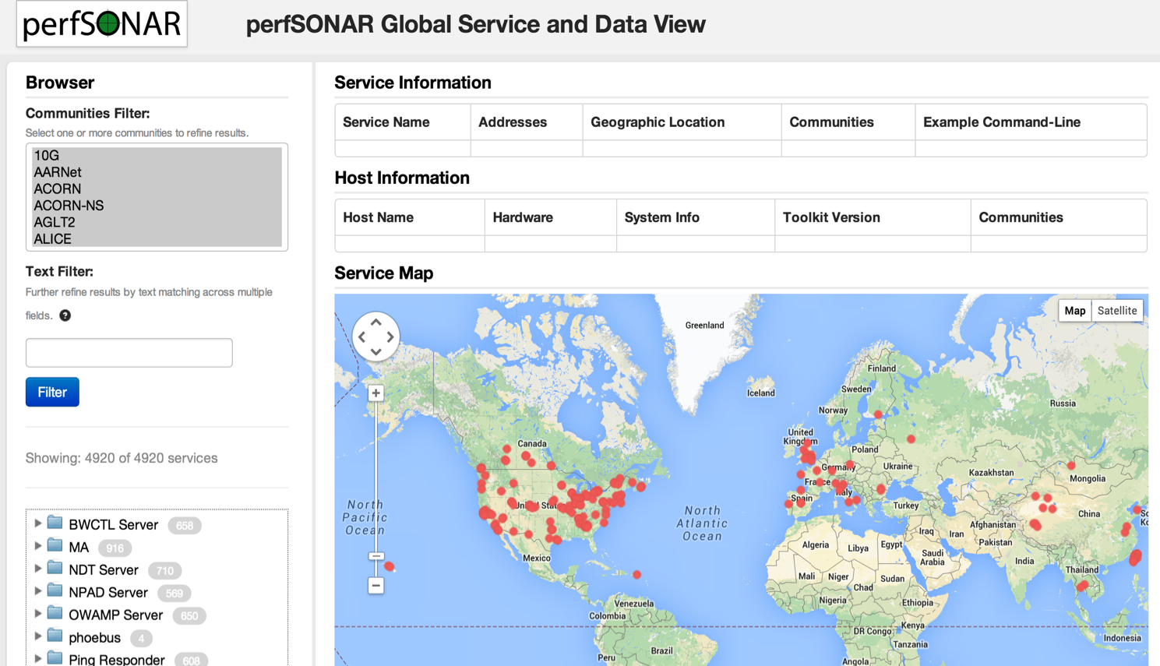
Lookup Service Directory Search: http://stats.es.net/ServicesDirectory/
© 2014, Energy Sciences Network
Notes:
How to find perfSONAR servers and services

Slide 69
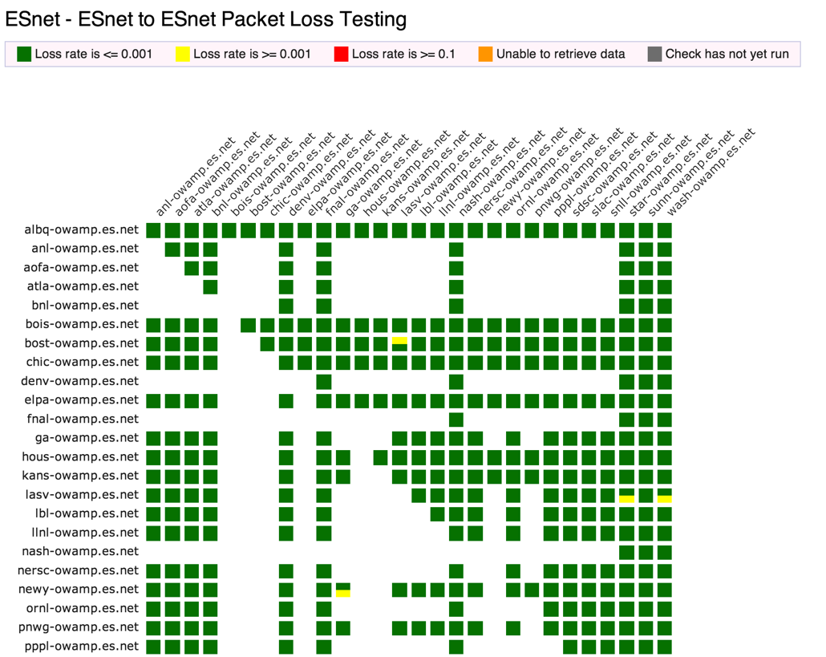
perfSONAR Dashboard: http://ps-dashboard.es.net
© 2014, Energy Sciences Network
Notes:
Integrating regular testing into a visualization (ESnet example).
Performance data is public
The tool can trigger alerts to notify NOC staff.
This is a very valuable tool for setting expectations

Slide 70
Overview
Science DMZ Motivation and Introduction
Science DMZ Architecture
Network Monitoring
Data Transfer Nodes & Applications
Science DMZ Security
User Engagement
Wrap Up
© 2014, Energy Sciences Network

Slide 71
Dedicated Systems – Data Transfer Node
The DTN is dedicated to data transfer
Set up specifically for high-performance data movement
System internals (BIOS, firmware, interrupts, etc.)
Network stack
Storage (global filesystem, Fibrechannel, local RAID, etc.)
High performance tools
No extraneous software
Limitation of scope and function is powerful
No conflicts with configuration for other tasks
Small application set makes cybersecurity easier
© 2014, Energy Sciences Network
Notes:
All aspects of the DTN must be tuned – even the BIOS matters
Limit the scope of the DTN as well – its job is data movement, its job is not to have office software on it.
Craft a specific security profile/policy around its only task.

Slide 72
Data Transfer Tools For DTNs
Parallelism is important
It is often easier to achieve a given performance level with four parallel connections than one connection
Several tools offer parallel transfers, including Globus/GridFTP
Latency interaction is critical
Wide area data transfers have much higher latency than LAN transfers
Many tools and protocols assume a LAN
Workflow integration is important
Key tools: Globus Online, HPN-SSH
© 2014, Energy Sciences Network
Notes:
DTN is entry point for data from multi-facility workflows – use the right tool for the right job

Slide 73

Data Transfer Tool Comparison
In addition to the network, using the right data transfer tool is critical
Data transfer test from Berkeley, CA to Argonne, IL (near Chicago). RTT = 53 ms, network capacity = 10Gbps.
Tool Throughput
scp: 140 Mbps
HPN patched scp: 1.2 Gbps
ftp 1.4 Gbps
GridFTP, 4 streams 5.4 Gbps
GridFTP, 8 streams 6.6 Gbps
Note that to get more than 1 Gbps (125 MB/s) disk to disk requires properly engineered storage (RAID, parallel filesystem, etc.)
© 2014, Energy Sciences Network
Notes:
Comparison of legacy and recommended tools.
Note that rsync over HPN-SSH is reasonable in a 1Gbps environment – if you are stuck with rsync over SSH, at least use HPN-SSH.
Globus is now deployed at a large number of major scientific sites – the basic data transfer functionality is free.

Slide 74
Overview
Science DMZ Motivation and Introduction
Science DMZ Architecture
Network Monitoring
Data Transfer Nodes & Applications
Science DMZ Security
User Engagement
Wrap Up
© 2014, Energy Sciences Network

Slide 75
Science DMZ Security
Goal – disentangle security policy and enforcement for science flows from security for business systems
Rationale
Science data traffic is simple from a security perspective
Narrow application set on Science DMZ
Data transfer, data streaming packages
No printers, document readers, web browsers, building control systems, financial databases, staff desktops, etc.
Security controls that are typically implemented to protect business resources often cause performance problems
Separation allows each to be optimized
© 2014, Energy Sciences Network

Slide 76
Performance Is A Core Requirement
Core information security principles
Confidentiality, Integrity, Availability (CIA)
Often, CIA and risk mitigation result in poor performance
In data-intensive science, performance is an additional core mission requirement: CIA → PICA
CIA principles are important, but if performance is compromised the science mission fails
Not about “how much” security you have, but how the security is implemented
Need a way to appropriately secure systems without performance compromises
© 2014, Energy Sciences Network
Notes:
You can still have really tight security if you need really tight security – just do it in a way that does not cause performance problems for traffic permitted by policy

Slide 77
Placement Outside the Firewall
The Science DMZ resources are placed outside the enterprise firewall for performance reasons
The meaning of this is specific – Science DMZ traffic does not traverse the firewall data plane
Packet filtering is fine – just don’t do it with a firewall
Lots of heartburn over this, especially from the perspective of a conventional firewall manager
Lots of organizational policy directives mandating firewalls
Firewalls are designed to protect converged enterprise networks
Why would you put critical assets outside the firewall???
The answer is that firewalls are typically a poor fit for high-performance science applications
© 2014, Energy Sciences Network
Notes:
Packets do not traverse a firewall device
Firewalls are typically engineered very differently than routers and switches

Slide 78
Firewall Internals
Typical firewalls are composed of a set of processors which inspect traffic in parallel
Traffic distributed among processors such that all traffic for a particular connection goes to the same processor
Simplifies state management
Parallelization scales deep analysis
Excellent fit for enterprise traffic profile
High connection count, low per-connection data rate
Complex protocols with embedded threats
Each processor is a fraction of firewall link speed
Significant limitation for data-intensive science applications
Overload causes packet loss – performance crashes
© 2014, Energy Sciences Network
Notes:
Each individual processor is typically a fraction of link speed (e.g. eight 1.25Gbps processors for a 10G firewall)

Slide 79
What’s Inside Your Firewall?
Vendor: “but wait – we don’t do this anymore!”
It is true that vendors are working toward line-rate 10G firewalls, and some may even have them now
10GE has been deployed in science environments for over 10 years
Firewall internals have only recently started to catch up with the 10G world
100GE is being deployed now, 40Gbps host interfaces are available now
Firewalls are behind again
In general, IT shops want to get 5+ years out of a firewall purchase
This often means that the firewall is years behind the technology curve
Whatever you deploy now, that’s the hardware feature set you get
When a new science project tries to deploy data-intensive resources, they get whatever feature set was purchased several years ago
© 2014, Energy Sciences Network
Notes:
As an element of network design, the enterprise firewall is a poor fit for high-performance scientific applications
Find another way to secure the high-performance scientific applications

Slide 80
The Firewall State Table
Many firewalls use a state table to improve performance
State table lookup is fast
No need to process entire ruleset for every packet
Also allows session tracking (e.g. TCP sequence numbers)
State table built dynamically
Incoming packets are matched against the state table
If no state table entry, go to the ruleset
If permitted by ruleset, create state table entry
Remove state table entry after observing connection teardown
Semantically similar to punt-and-switch model of traffic forwarding used on many older routers
© 2014, Energy Sciences Network

Slide 81
State Table Issues
If the state table is not pruned, it will overflow
Not all connections close cleanly
I shut my laptop and go to a meeting
Software crashes happen
Some attacks try to fill state tables
Solution: put a timer on state table entries
When a packet matches the state table entry, update the timer
If the timer expires, delete the state table entry
What if I just pause for a few minutes?
This turns out to be a problem – state table timers are typically in the 5-15 minute range, while host keepalive timers are 2 hours
If a connection pauses (e.g. control channel waits for a large transfer), the firewall will delete the state table entry from under it – the control connection now hangs
We have seen this in production environments
© 2014, Energy Sciences Network
Notes:
Enterprise firewall designers assume that everything is an email, a web browser, or streaming content
Science environments are more complex than that – they make use of the full set of capabilities available
If you violate the assumptions of an enterprise firewall, you experience denial of service – by design!

Slide 82
Firewall Capabilities and Science Traffic
Firewalls have a lot of sophistication in an enterprise setting
Application layer protocol analysis (HTTP, POP, MSRPC, etc.)
Built-in VPN servers
User awareness
Data-intensive science flows typically don’t match this profile
Common case – data on filesystem A needs to be on filesystem Z
Data transfer tool verifies credentials over an encrypted channel
Then open a socket or set of sockets, and send data until done (1TB, 10TB, 100TB, …)
One workflow can use 10% to 50% or more of a 10G network link
Do we have to use a firewall?
© 2014, Energy Sciences Network

Slide 83
Firewalls As Access Lists
When you ask a firewall administrator to allow data transfers through the firewall, what do they ask for?
IP address of your host
IP address of the remote host
Port range
That looks like an ACL to me!
No special config for advanced protocol analysis – just address/port
Router ACLs are better than firewalls at address/port filtering
ACL capabilities are typically built into the router
Router ACLs typically do not drop traffic permitted by policy
© 2014, Energy Sciences Network
Notes:
Remember – we have mission requirements for high performance scientific data mobility, and business requirements for cost efficiency.
A firewall mandate is an expensive solution that is a poor match for the task at hand and jeopardizes the scientific mission of the organization.

Slide 84
Security Without Firewalls
Data intensive science traffic interacts poorly with firewalls
Does this mean we ignore security? NO!
We must protect our systems
We just need to find a way to do security that does not prevent us from getting the science done
Key point – security policies and mechanisms that protect the Science DMZ should be implemented so that they do not compromise performance
Traffic permitted by policy should not experience performance impact as a result of the application of policy
© 2014, Energy Sciences Network

Slide 85
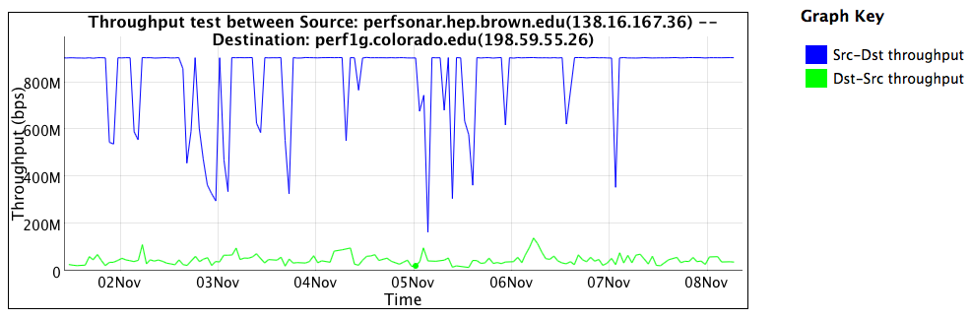
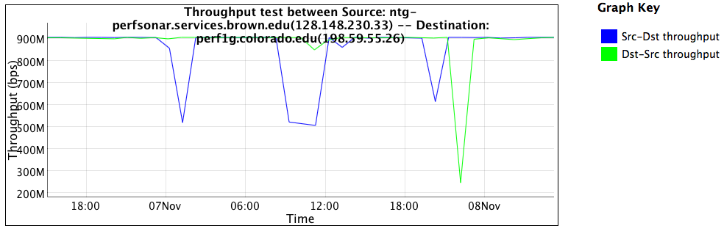
Firewall Performance Example
Observed performance, via perfSONAR, through a firewall:
Observed performance, via perfSONAR, bypassing firewall:
Almost 20 times slower through the firewall
Huge improvement without the firewall
© 2014, Energy Sciences Network
Notes:
Real life example, in front of and in back of a firewall that was dramatically impacting performance
perfSONAR is good at finding these issues
Engineers still have to take action to fix the problem

Slide 86
If Not Firewalls, Then What?
Remember – the goal is to protect systems in a way that allows the science mission to succeed
I like something I heard at NERSC – paraphrasing: “Security controls should enhance the utility of science infrastructure.”
There are multiple ways to solve this – some are technical, and some are organizational/sociological
I’m not going to lie to you – this is harder than just putting up a firewall and closing your eyes
© 2014, Energy Sciences Network
Notes:
It will probably work better because the firewall isn’t doing that much for high-performance DTNs anyway

Slide 87
Other Technical Capabilities
Intrusion Detection Systems (IDS)
One example is Bro – http://bro-ids.org/
Bro is high-performance and battle-tested
Bro protects several high-performance national assets
Bro can be scaled with clustering: http://www.bro-ids.org/documentation/cluster.html
Other IDS solutions are available also
Netflow and IPFIX can provide intelligence, but not filtering
Openflow and SDN
Using Openflow to control access to a network-based service seems pretty obvious
This could significantly reduce the attack surface for any authenticated network service
This would only work if the Openflow device had a robust data plane
© 2014, Energy Sciences Network

Slide 88
Other Technical Capabilities (2)
Aggressive access lists
More useful with project-specific DTNs
If the purpose of the DTN is to exchange data with a small set of remote collaborators, the ACL is pretty easy to write
Large-scale data distribution servers are hard to handle this way (but then, the firewall ruleset for such a service would be pretty open too)
Limitation of the application set
One of the reasons to limit the application set in the Science DMZ is to make it easier to protect
Keep desktop applications off the DTN (and watch for them anyway using logging, netflow, etc – take violations seriously)
This requires collaboration between people – networking, security, systems, and scientists
© 2014, Energy Sciences Network

Slide 89
Collaboration Within The Organization
All stakeholders should collaborate on Science DMZ design, policy, and enforcement
The security people have to be on board
Remember: security people already have political cover – it’s called the firewall
If a host gets compromised, the security officer can say they did their due diligence because there was a firewall in place
If the deployment of a Science DMZ is going to jeopardize the job of the security officer, expect pushback
The Science DMZ is a strategic asset, and should be understood by the strategic thinkers in the organization
Changes in security models
Changes in operational models
Enhanced ability to compete for funding
Increased institutional capability – greater science output
© 2014, Energy Sciences Network

Slide 90
Overview
Science DMZ Motivation and Introduction
Science DMZ Architecture
Network Monitoring
Data Transfer Nodes & Applications
Science DMZ Security
User Engagement
Wrap Up
© 2014, Energy Sciences Network

Slide 91
Science DMZ Superfecta: Engagement
Engagement
Partnerships
Education & Consulting
Resources & Knowledgebase
Engagement with Network Users
perfSONAR
Enables fault isolation
Verify correct operation
Widely deployed in ESnet and other networks, as well as sites and facilities
Data Transfer Node
High performance
Configured for data transfer
Proper tools
Dedicated Systems for Data Transfer
Performance Testing & Measurement
Network Architecture
Science DMZ
Dedicated location for DTN
Proper security
Easy to deploy - no need to redesign the whole network
© 2014, Energy Sciences Network
Notes:
The trifecta of DMZ, DTN, and perfSONAR is sufficient if your users already understand
If you want to do this right, include user engagement as an integral part of the Science DMZ so that users can be brought in - this is what ESnet does

Slide 92
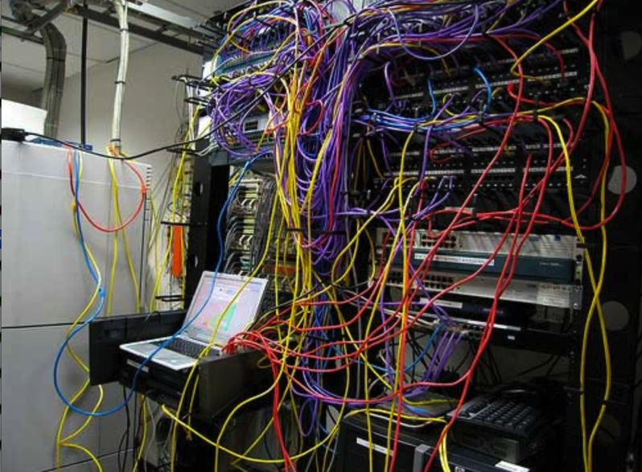
Challenges to Network Adoption
Causes of performance issues are complicated for users.
Lack of communication and collaboration between the CIO’s office and researchers on campus.
Lack of IT expertise within a science collaboration or experimental facility
User’s performance expectations are low (“The network is too slow”, “I tried it and it didn’t work”).
Cultural change is hard (“we’ve always shipped disks!”).
Scientists want to do science not IT support
The Capability Gap
© 2014, Energy Sciences Network
Notes:
The struggle in engagement – management, engineering, and users often have dug in on bad behavior.
This amounts a capability gap – there is a disconnect from the capabilities of the network and the ability of the scientists to effectively use it
To fix this, we need to get everyone working toward a common goal:
- Management must fund and support the base needs of research
- IT is there to support the users in doing things correctly, and having all components work

Slide 93
Overview
Science DMZ Motivation and Introduction
Science DMZ Architecture
Network Monitoring
Data Transfer Nodes & Applications
On the Topic of Security
User Engagement
Wrap Up
© 2014, Energy Sciences Network

Slide 94
Futures
The Science DMZ design pattern is highly adaptable to new technologies
Software Defined Networking (SDN)
Non-IP protocols (RDMA over Ethernet)
Deploying new technologies in a Science DMZ is straightforward
The basic elements are the same
Capable infrastructure designed for the task
Test and measurement to verify correct operation
Security policy well-matched to the environment
Application set strictly limited to reduce security risk
Change footprint is small – often just a single router or switch
The rest of the infrastructure need not change
© 2014, Energy Sciences Network

Slide 95
Wrapup
The Science DMZ design pattern provides a flexible model for supporting high-performance data transfers and workflows
Key elements:
Accommodation of TCP
Sufficient bandwidth to avoid congestion
Loss-free IP service
Location – near the site perimeter if possible
Test and measurement
Dedicated systems
Appropriate security
Support for advanced capabilities (e.g. SDN) is much easier with a Science DMZ
© 2014, Energy Sciences Network

Slide 96
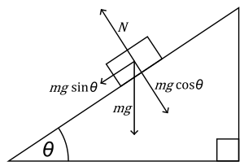

The Science DMZ in 1 Slide
Consists of three key components, all required:
“Friction free” network path
Highly capable network devices (wire-speed, deep queues)
Virtual circuit connectivity option
Security policy and enforcement specific to science workflows
Located at or near site perimeter if possible
Dedicated, high-performance Data Transfer Nodes (DTNs)
Hardware, operating system, libraries all optimized for transfer
Includes optimized data transfer tools such as Globus Online and GridFTP
Performance measurement/test node
perfSONAR
Engagement with end users
Details at http://fasterdata.es.net/science-dmz/
© 2013 Wikipedia
© 2014, Energy Sciences Network
Notes:
Single slide summary

Slide 97
Links
ESnet fasterdata knowledge base
http://fasterdata.es.net/
Science DMZ paper
http://www.es.net/assets/pubs_presos/sc13sciDMZ-final.pdf
Science DMZ email list
https://gab.es.net/mailman/listinfo/sciencedmz
perfSONAR
http://fasterdata.es.net/performance-testing/perfsonar/
http://www.perfsonar.net
© 2014, Energy Sciences Network

Slide 98
Thanks!
Energy Sciences Network (ESnet)
Lawrence Berkeley National Laboratory
http://fasterdata.es.net/
http://my.es.net/
http://www.es.net/

Slide 99
Extra Slides – Firewall Internals
© 2014, Energy Sciences Network

Slide 100
Thought Experiment
We’re going to do a thought experiment
Consider a network between three buildings – A, B, and C
This is supposedly a 10Gbps network end to end (look at the links on the buildings)
Building A houses the border router – not much goes on there except the external connectivity
Lots of work happens in building B – so much that the processing is done with multiple processors to spread the load in an affordable way, and results are aggregated after
Building C is where we branch out to other buildings
Every link between buildings is 10Gbps – this is a 10Gbps network, right???
© 2014, Energy Sciences Network
Notes:
Go to next slide, speak to the diagram
The text on this slide is for people looking at the deck who are not present at the talk

Slide 101
Notional 10G Network Between Buildings
© 2014, Energy Sciences Network
Notes:
Building A houses the border router – not much goes on there except the external connectivity
Lots of work happens in building B – so much that the processing is done with multiple processors to spread the load in an affordable way, and results are aggregated after
Building C is where we branch out to other buildings

Slide 102
Clearly Not A 10Gbps Network
If you look at the inside of Building B, it is obvious from a network engineering perspective that this is not a 10Gbps network
Clearly the maximum per-flow data rate is 1Gbps, not 10Gbps
However, if you convert the buildings into network elements while keeping their internals intact, you get routers and firewalls
What firewall did the organization buy? What’s inside it?
Those little 1G “switches” are firewall processors
This parallel firewall architecture has been in use for years
Slower processors are cheaper
Typically fine for a commodity traffic load
Therefore, this design is cost competitive and common
© 2014, Energy Sciences Network

Slide 103
Notional 10G Network Between Devices
© 2014, Energy Sciences Network
Notes:
Now, convert the buildings into network devices
Building A becomes a border router
Building B becomes a firewall
Building C becomes a core router

Slide 104
Notional Network Logical Diagram
© 2014, Energy Sciences Network
Notes:
If you’re not allowed to look inside, this is all you see
This network is broken, but unless you know to go look you’ll never know why

Slide 105
Extra Slides – Initial Data Intensive Science Network
© 2014, Energy Sciences Network

Slide 106
Ad Hoc DTN Deployment
This is often what gets tried first
Data transfer node deployed where the owner has space
This is often the easiest thing to do at the time
Straightforward to turn on, hard to achieve performance
If present, perfSONAR is at the border
This is a good start
Need a second one next to the DTN
Entire LAN path has to be sized for data flows
Entire LAN path is part of any troubleshooting exercise
This usually fails to provide the necessary performance.
© 2014, Energy Sciences Network
Notes:
Call this a ‘converged’ network, its what your local vendor rep will try to sell you
Converged does not work for science – and we can point to the insertion of a fully tuned DTN host as the counter case. The host can work well, but the network won’t due to things like congestion, buffering, security devices, etc.
This is what frustrates users most of all – they bought a new $20k server to run a high-performance tool, and they will be very mad when they get the same performance they would out of something 10 years old using SCP.

